Slide 1
Introduction to Federal Income Tax Law
Tax Year 2018
Notes:
Release 2 slide changes:
Slide 10 – Income and adjustments are on Schedule 1, Tax on Schedule 2, nonrefundable credits on Schedule 3
Slides 14, 15, 16 (old 15), 19 old 18), 23 (old 21) Updated screen shots
Expanded Slide 15 by adding Slide 16
Added new Slide 20 for Practice Lab
Minor tense changes to reflect present versus future.

Slide 2
Tax Law Basics
All income is taxable,
unless the law says it is not
No deduction is allowed,
unless the law says it is
No credit is allowed,
unless the law says it is

Slide 3
Tax Law Basics
Gross Income
Minus adjustments
= Adjusted gross Income
Minus deductions
= Taxable Income

Slide 4
Types of Income
Pub 4012 Tab D
Two types of income
Taxable
Earned
Unearned
Nontaxable
Earned
Unearned

Slide 5
Types of Income
Pub 4012 Tab D
Taxable income
Must be reported
Subject to tax
Nontaxable income
May be reportable
Exempt from tax
Notes:
Pub 4012 Tab D Table A Table B examples of both types of income

Slide 6
Types of Income
Examples of earned income: income received from work
Wages
Self-employment
Long term disability payments prior to minimum retirement age
Union strike benefits
Notes:
Must have earned income to qualify for EIC. Medicaid waiver payments are not considered earned income for the purposes of EIC.

Slide 7
Types of Income
Examples of unearned income: income not produced from work
Unemployment compensation
Interest and dividends
Capital gains
Social security benefits
Retirement income
Schedule E rental income
Scholarship income
Alimony
Certain qualified Medicaid waiver payments
Notes:
Alimony is considered compensation for the purpose of contributing to an IRA.
Qualified (excluded) Medicaid waiver payments are not earned income for the purpose of EIC, the dependent care credit, nor additional child tax credit. See the Medicaid Waiver Payments slide presentation.

Slide 8
Types of Deductions
Adjustments and deductions reduce taxable income
Two types
Adjustments to gross income
Itemized or standard deduction
Notes:
Itemized deduction are on Schedule A and can be claimed instead of the standard deduction
TaxSlayer will select the one that yields the lowest tax

Slide 9
Types of Credits
Credits reduce tax liability dollar for dollar
Nonrefundable
Limited to tax liability
Cannot reduce tax liability below $0
Refundable
Can reduce tax liability below $0
Entered in payment section Form 1040

Slide 10
Form 1040 and Related Schedules
Filing status, identity and dependents
Income and adjustments (additional income on Schedule 1)
Tax (on Schedule 2)
Deductions (itemized deductions on Schedule A)
Nonrefundable credits (on Schedule 3)
Additional taxes (on Schedule 4)
Refundable credits and payments (some on Schedule 5)

Slide 11
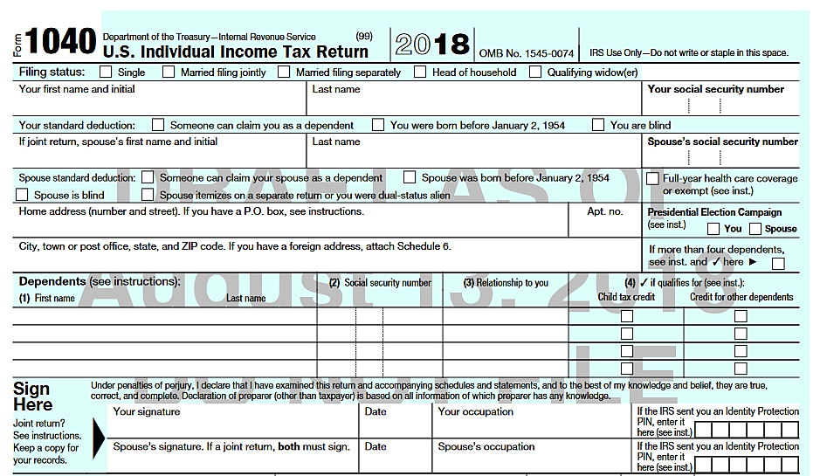
Form 1040

Slide 12
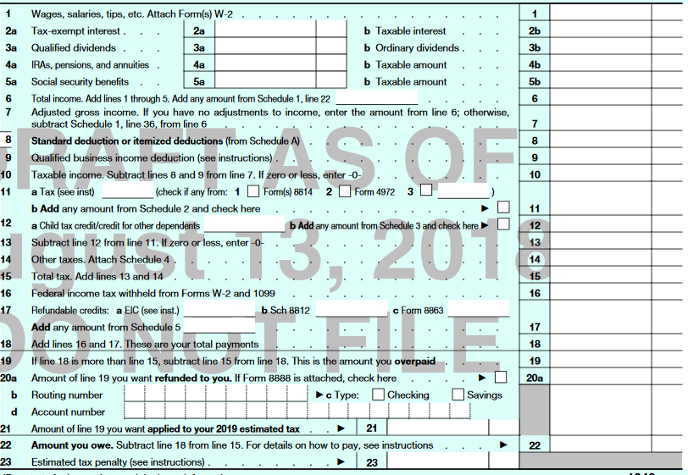
Form 1040 Page 2
Income
Deductions
`
Nonrefundable
credits
Other taxes
Payments and
refundable
credits

Slide 13
Training Materials
Pub 4491 – Training Guide
NTTC Workbook – Practice Exercises
Pub 4012 – Volunteer Resource Guide
Form 6674 – Certification Test and Retest
TaxSlayer Practice Lab – Sections 4 & 6 of HOME page
linklearncertification.com
Pub 17 – Your Federal Income Tax for Individuals
Notes:
Pub 17 hardcopy will be shipped by SPEC two copies per site
For training, volunteers can use the electronic version found on irs.gov

Slide 14
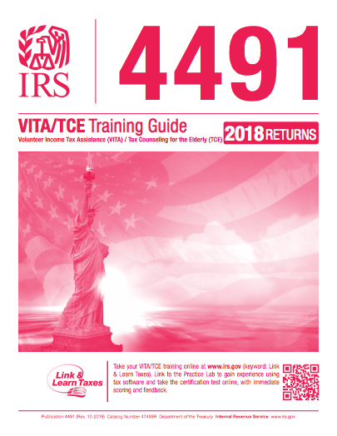
VITA/TCE Training Guide
The Text Book
Paper and on line for 2018
NTTC version in Portal library
Notes:
This Pub has been updated for 2018 and is available Electronically and printed

Slide 15
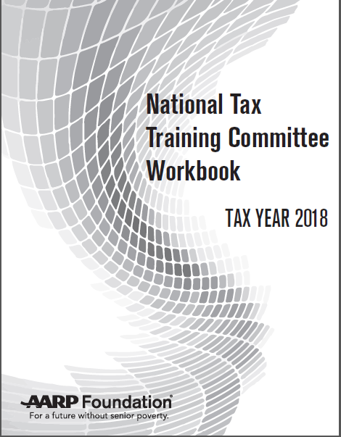
NTTC Workbook
The Workbook
Available to order
In Portal Library
Notes:
See next slide for features of NTTC workbook.

Slide 16
NTTC Workbook
Training exercises (new)
Practice exercises
Quizzes
Available in Portal Library and by ordering through Portal

Slide 17
NTTC Workbook – Practice Exercises
New Practice Exercises format this year
Focus Exercises (NEW)
Core Exercises
Comprehensive Exercises
Specialty Exercises

Slide 18
Two Types of Exercises
Training Exercises
Practice Exercises
For Instructor to use in a classroom setting
Contain all the core topics usually encountered on the Advanced Exam
Separate Instructor Guide
For volunteers to reinforce/refresh knowledge and skill
For volunteers to demonstrate proficiency and meet certification requirements

Slide 19
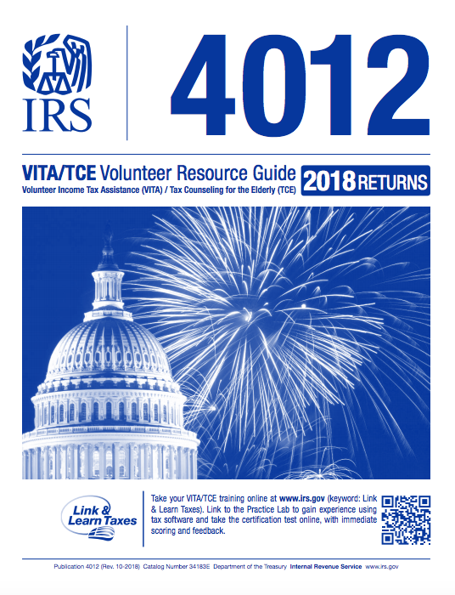
Volunteer Resource Guide
The Golden Book
Primary reference tool
Contains ‘What’s New’ Tab
NTTC version in Portal Library (Recommended)
Notes:
The 2018 version of the Volunteer Resource Guide will be unbound, 3 – hole punched with a 1” ring
(no binder) and shrink-wrapped. It will be necessary to insert the tabs.

Slide 20
TaxSlayer Practice Lab Tools
Training Videos
Practice Problems

Slide 21
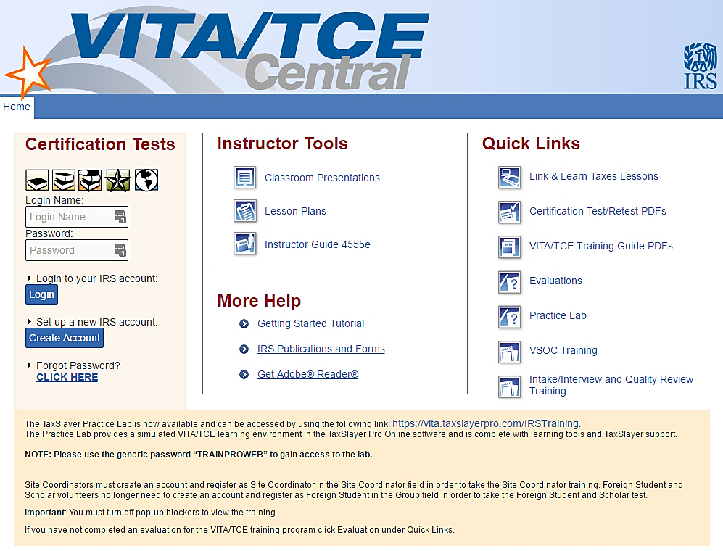
VITA/TCE Central
https://www.linklearncertification.com/
Notes:
IRS Link and Learn front page.

Slide 22
Notes:
Certification Tests--create an account and note your login and password.
Instructor Tools
Quick Links including online lesson and Practice Lab
More Help

Slide 23
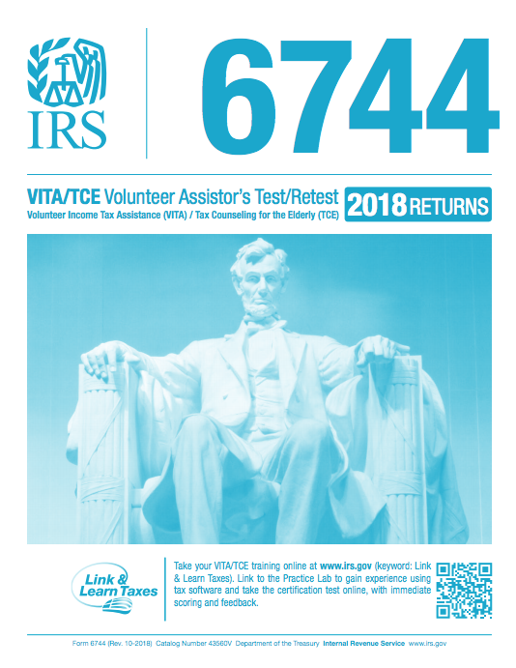
VITA/TCE Volunteer Assistor’s Test/Retest
Contains all Tests
3 Tests are required
Test Questions are similar to online test questions, but wording may be different –be careful

Slide 24
Introduction to Income Tax
Questions…
Comments…

